Slide 1


Economic Outlook Update
Back to Reality
Ben Forrester
Macquarie Private Bank
June 2019

Slide 2
The Fed gives risk assets a reprieve but is it too little too late?…
    The 3 cycles determining the outlook:
      Economic cycle: Global momentum stabilized in 1Q19 but is again weakening. Trade wars are threatening the 2H19 recovery;
      Liquidity cycle: Fed cuts are coming in order to provide insurance against growth weakness. Rate cuts are already priced into bonds and equities. Trump has not weaponized the US$ yet;
      Political cycle: Global political risks are rising. US-China trade spat, BREXIT, EU elections. Don’t expect a speedy resolution to bilateral trade war;
    Equities are at risk of disappointment from the Fed, but the bull market and economic cycle is not yet over. We are entering the riskier end of the rally – less upside but with greater volatility.
    US and EM’s remain our preferred global equity markets, still looking for duration (lower long rates) and credit exposure within fixed income.

Slide 3
Australian gets a troika of gifts…
    Australia is set to benefit from a more investor friendly government along with policy easing and a freeing up of credit.
    Offshore risks still threaten the market outlook but domestic risks are being reduced particularly around housing and wealth impacts on spending;
    What can investors and households expect?
        Australian equity returns of between 6-7%pa;
        Cash rates to converge to zero (or thereabouts);
        House price growth to revert back inline with income growth at 2-4%ps;
        Increased allocations towards “yield” and “cash” substitutes but at greater risk;
        Balanced portfolio returns to fall via lower cash returns, bond returns and equity returns;
        A$ going sideways.

Slide 4

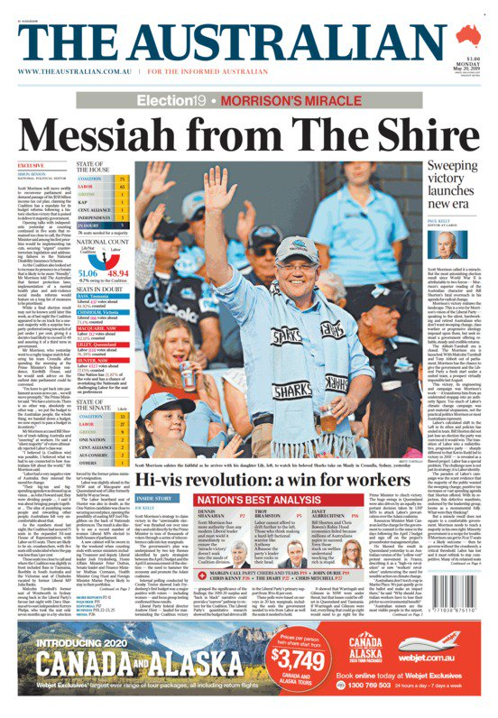
A miracle victory, but “hope” is not a good investment strategy

Slide 5
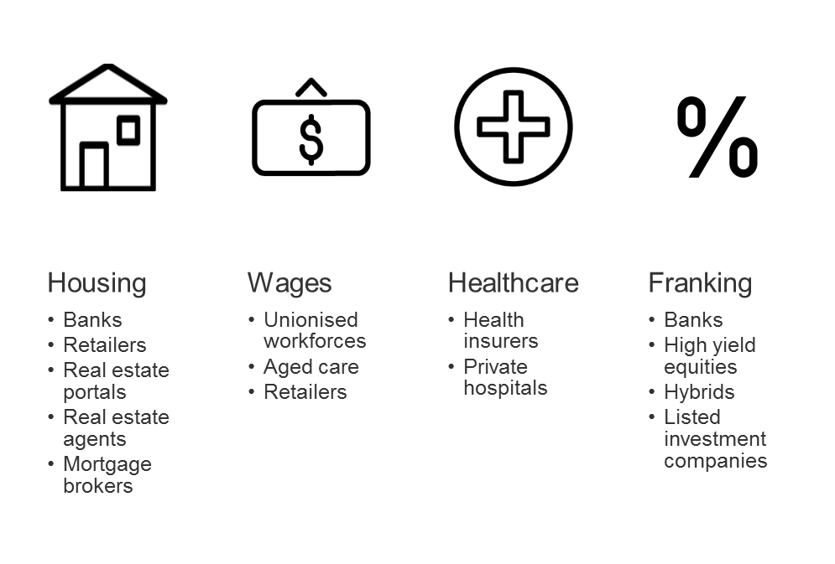
Where do the benefits flow?
Source: ABS, Bloomberg, Macquarie

Slide 6
Global Economic Outlook
Cyclical risks increasing….

Slide 7
GDP growth in the major economies is weakening and the decline is not just trade related. Manufacturing declined in May even before trade issues hit…
Source: IHS Markit, IMF, Macrobond, Macquarie

Slide 8
The slump in global trade has been a key factor in weakness, with trade volumes falling more than IP and final demand…
Source: Macrobond, Macquarie

Slide 9
The effects of the bilateral trade war have already been felt but no one wins from a multilateral trade war. The Fed needs to work hard to offset trade impacts…
Source: Oxford Economics, US Census Bureau, USTR, Macrobond, Macquarie

Slide 10
Signs of growth weakness are spreading and include oil, base metals, bonds, and cyclical equity market sectors…
Source: Oxford Economics, US Census Bureau, USTR, Macrobond, Macquarie

Slide 11
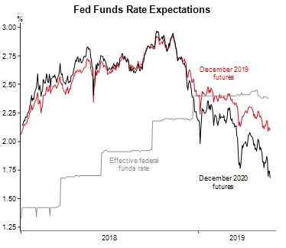
Fed to the rescue again, and again, and again...
Source: Bloomberg, Macrobond, MWM Research, May 2019

Slide 12
Time to panic?...Not yet, but equities and not bonds are most at risk if conditions deteriorate….
Source: Oxford Economics, Macquarie

Slide 13
Australian Economic Outlook
Policy support needed for a weak outlook

Slide 14
The outlook for Australia remains weak, with GDP slowing, and offshore uncertainty high. A recovery in housing will boost sentiment and spending
Source: ABS, NAB, Macrobond, Macquarie

Slide 15
Weak income growth remains a major headwind for the consumption outlook and is not likely to pick up quickly but tax relief will help for a short term boost…
Source: ABS, Macquarie Macro Strategy

Slide 16
Traditionally RBA rate cuts have driven higher house prices on both a 12 and 18 months basis. The recovery in housing sentiment has been dramatic…
Source: APM, CoreLogic RPData, Macquarie

Slide 17
APRA’s removal of the minimum interest rate hurdle will raise borrowing capacity by a substantial amount in coming quarters
Source: Bloomberg, FactSet, Macrobond, Macquarie

Slide 18
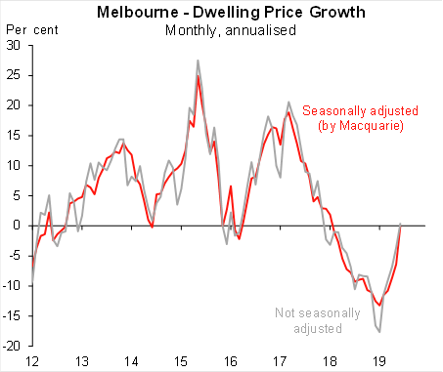
The housing market is at the epicentre of Australian concerns. Clearance rates and prices are already bouncing back…
Source: APM, CoreLogic RPData, Macquarie

Slide 19
Construction activity is still set to decline but any improvement in dwelling activity should also help drive improving housing related retail sales…
Source: APM, CoreLogic RPData, Macquarie

Slide 20
Australian debt levels remain extremely elevated, but debt servicing costs continue to decline. There has been no deleveraging as house prices have fallen
Source: APM, CoreLogic RPData, Macquarie

Slide 21
Price to income ratios have declined, but only back to 2016 levels. However, falling mortgage rates have reduced debt servicing costs substantially…
Source: APM, CoreLogic RPData, Macquarie

Slide 22
Iron ore above $100/t but bond yield differentials have collapsed….
Source: ABS, Bloomberg, Macquarie

Slide 23
Why is the A$ still so strong…Trade balance at a 45 year high
Source: ABS, Bloomberg, Macquarie

Slide 24
With underlying inflation continuing to soften, the RBA has 50bps in its sights with potentially more if needed…
Source: ABS, Bloomberg, Macquarie

Slide 25
Market Outlook
Have the easy gains already been made?

Slide 26
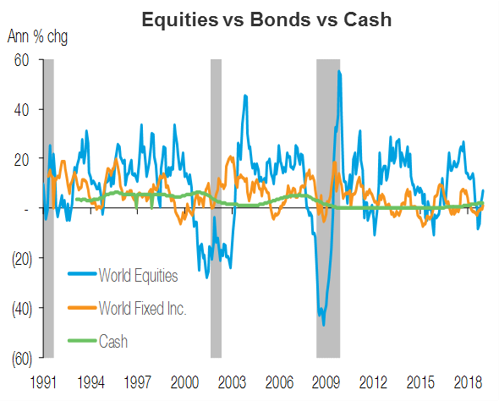
The bull market is still intact, equities are still preferred to bonds and cash but return differentials are set to narrow as the cycle continues to mature and rates reach a zero bound
Source: MSCI, Barclays, Bloomberg, Macquarie, May-19

Slide 27
The Australian equity market is trading at historic valuation highs but can move higher if cyclically depressed areas re-rate. There is still plenty of market cap that can re-rate if policy support emerges
Source: FactSet, Macquarie

Slide 28
Australia has substantially lagged global developed markets due to weak earnings growth. Earnings growth remains elusive
Source: Bloomberg, FactSet, Macrobond, Macquarie

Slide 29
How much risk will investors take on to offset declining cash returns?
Source: FactSet, Macquarie Research, May 2019

Slide 30
Australian earnings growth has been lacking post the GFC but yet this is not stopped investors from remaining overweight in order to access dividends.
Source: Bloomberg, ATO, FactSet, Macquarie

Slide 31
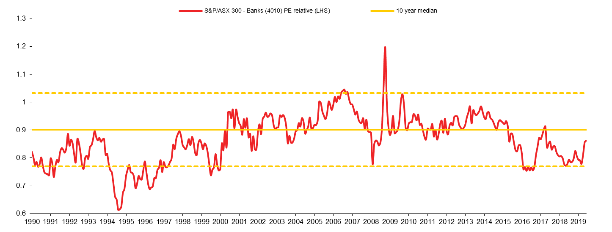
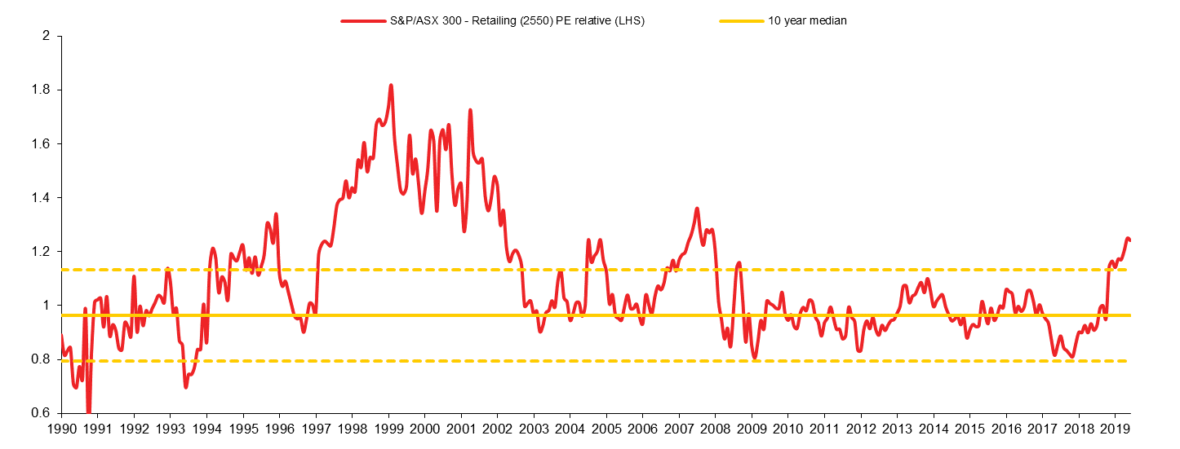
Where is the value in the market? Deep domestic cyclicals….autos, builders, capital goods but not banks or retail…
Source: FactSet, Macquarie Research, May 2019

Slide 32
Declining cash rates are negative for banks given already low deposit rates…
Source: Bloomberg, FactSet, Macrobond, Macquarie

Slide 33
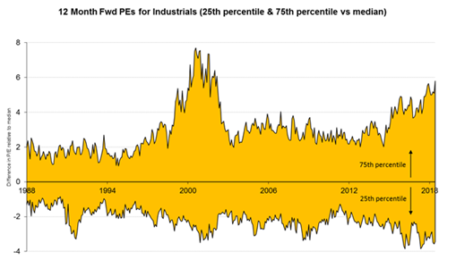
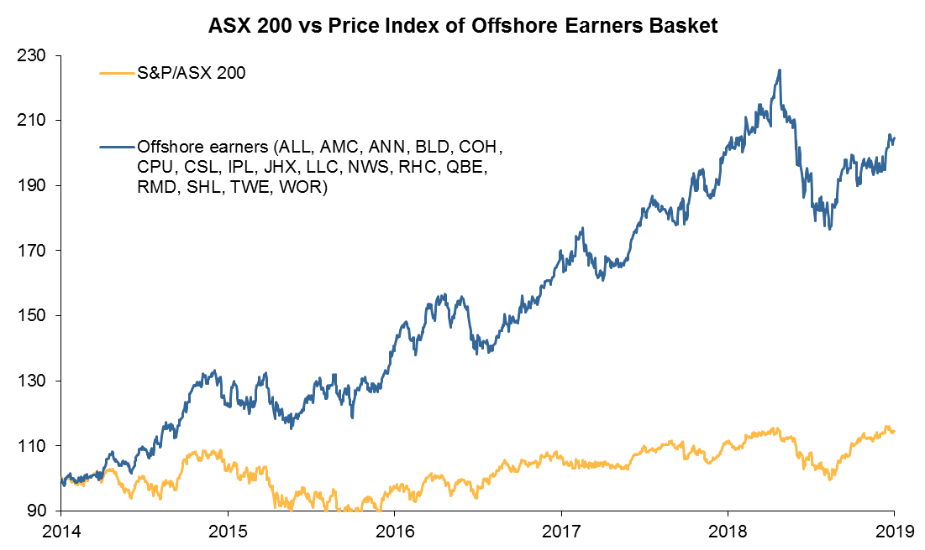
Recovery in cyclical areas will require broader improvement in growth. Offshore earners still getting weak A$ pick-up
Source: Bloomberg, FactSet, Macrobond, Macquarie

Slide 34
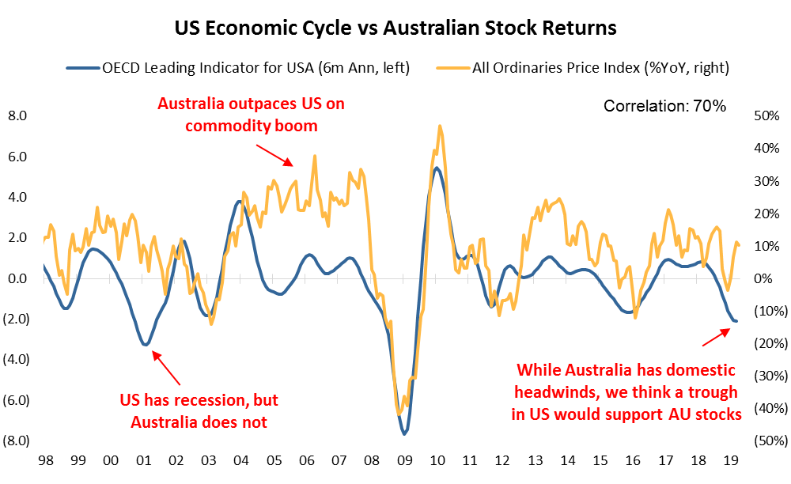
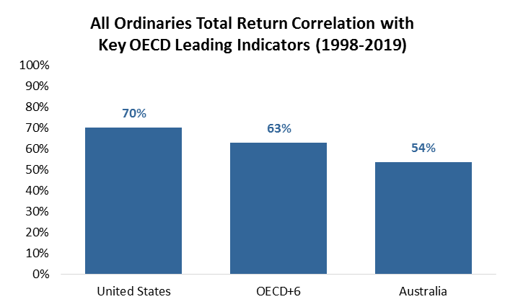
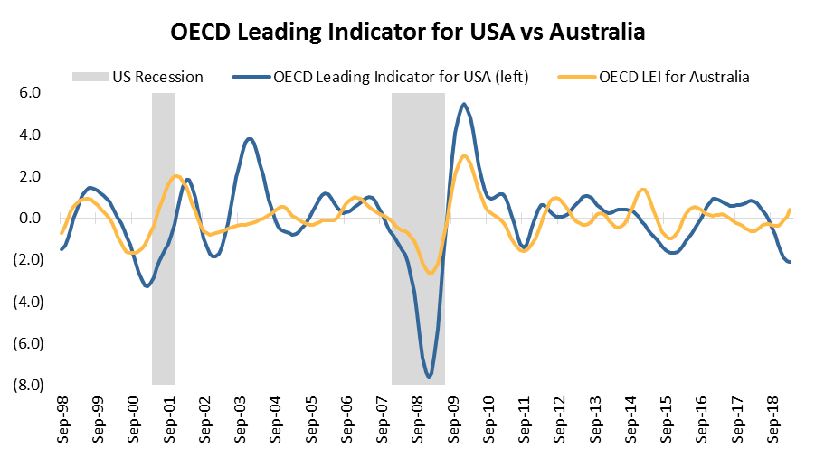
The US leading indicator has a strong link with ASX stock returns. An improving cyclical outlook is positive for Australia. But…how strong will cyclical improvement be?
Source: FactSet, Macquarie Research, May 2019

Slide 35
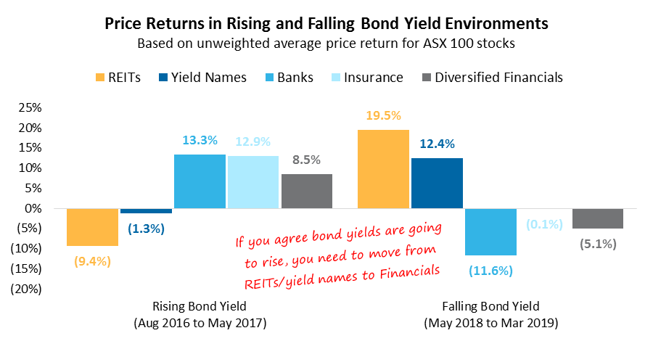
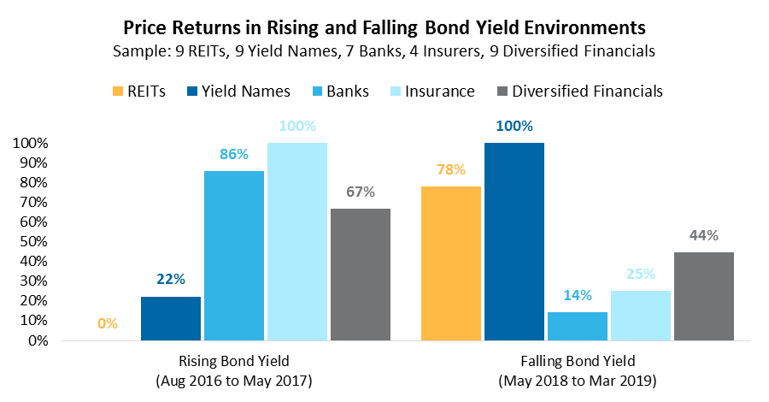
Rising bond yields favour Financials over bond proxies
If you look at individual stock returns, the last time bond yields rose strongly, REITs and other bond proxies underperformed.
Financials perform better when bond yields rise.
Source: FactSet, Macquarie Research, May 2019

Slide 36
Recovery phase is the strongest for equities, value over growth and small caps
Source: FactSet, Macquarie Research, May 2019

Slide 37
Australian Equity Strategy
Last Portfolio Update – 24 May 2019
Portfolio Comments
Now concentrated in two banks, NAB (cheapest) and WBC (cheapest bank with high housing exposure).
Lifted weight in construction materials (adding CSR) as sector has underperformed and RBA likely to cut rates.
Recently added NEC for exposure to improved AU cycle. The ~60% interest in DHG plus REA position give house price exposure.
Reduced exposure to global cyclicals (ALL, BHP/RIO) in response to improved domestic outlook and the risk of higher bond yields and Australian Dollar.
The total return for the strategy portfolio from 25/1/19 to 24/5/19 is 13.34%, 134bps ahead of ASX 200.
Source: FactSet, Macquarie Research, May 2019

Slide 38
Global central banks have reversed previous balance sheet contraction. Money will remain ‘free’ for some time to come, but this will also keep fixed income returns low and investors chasing yield
G4+Swiss Central Bank Balance Sheet (US$ bn)
Source: Bloomberg, Macquarie May-19

Slide 39
It is rare for one asset class to dominate returns for multiple years…diversification is key to portfolios performance
All returns in AUD
Source: FactSet, MWM Research, March 2019

Slide 40
Important information:
This publication represents the views of the Sales and Trading Global Macro Strategy Department and/or Sales and Trading Desk strategists (collectively referred to as “Global Macro”) of Macquarie. It is not a product of Macquarie Research and the view of Global Macro may differ from the views of Macquarie Research and other divisions at Macquarie. Macquarie has policies in place to promote the independence of Macquarie Research and to manage conflicts of interest, including policies relating to dealing ahead of the dissemination of Macquarie Research. These policies do not apply to the views of Global Macro contained in this report.
Global Macro Disclosure
The name “Macquarie” refers to Macquarie Group Limited and its worldwide affiliates and subsidiaries (the Macquarie Group). This information is provided on a confidential basis and may not be reproduced, distributed or transmitted in whole or in part without the prior written consent of Macquarie.
This publication has been prepared by Macquarie Sales and Trading personnel and is not a product of the Macquarie Research Department. Any views or opinions expressed are the views of the author and the Macquarie Sales and/or Trading desk from which it originates (‘the Authors’) and those views may differ from those of the Macquarie Research Department. Prior to distribution of this publication, information contained herein may be shared with Macquarie Trading desks who are not subject to prohibitions on trading prior to the dissemination of this publication. The views are not independent or objective of the interests of the Authors and other Macquarie Sales and/or Trading desks that trade as principal in the financial instruments mentioned within and who may be compensated in part based on trading activity. The views do not include and are not intended as trading ideas or recommendations specifically tailored for the needs of any particular investor.
This communication is provided for information purposes only, is subject to change without notice and is not binding. Any prices or quotations in the information provided are indicative only, are subject to change without notice and may not be used or relied on for any purpose, including valuation purposes. This communication is not a solicitation to buy or sell any product, or to engage in, or refrain from engaging in, any transaction, except to the extent covered by the CFTC Rules (see Important Derivatives Disclosure). Nor does it constitute investment research, a research report or a personal or other recommendation. Nothing in the information provided should be construed as legal, financial, accounting, tax or other advice.
Important Derivatives Disclosure: This material constitutes a solicitation for entering into a derivatives transaction only for the purposes of, and to the extent it would otherwise be subject to, U.S Commodity Futures Trading Commission Regulations §§ 1.71 and 23.605 promulgated under the U.S. Commodity Exchange Act (the “CFTC Rules”). Futures options and derivatives products are not suitable for all investors and trading in these instruments involves substantial risk of loss.
Macquarie is a global provider of banking, financial advisory, investment and funds management services. As such, Macquarie may act in various roles including as provider of corporate finance, underwriter or dealer, holder of principal positions, broker, lender or adviser and may receive fees, brokerage or commissions for acting in those capacities. In addition, Macquarie and associated personnel may at any time buy, sell or hold interests in financial instruments referred to in this information either on behalf of clients or as principal. Therefore, this information should not be relied upon as either independent or objective from the interests of Macquarie and associated personnel which may conflict with your interests.
To the extent permitted by law, Macquarie accepts no responsibility or liability (in negligence or otherwise) for loss or damage resulting from the use of or relating to any error in the information provided. This information has been prepared in good faith and is based on information obtained from sources believed to be reliable, however, Macquarie is not responsible for information stated to be obtained from third party sources. Any modelling, scenario analysis, past or simulated past performance (including back-testing) contained in this information is no indication as to future performance.
Canada: This report has been prepared by an Economist/Desk Strategy analyst in the Institutional Sales Group based upon general comments by research analysts or other sources we believe to be reputable. This report should not be construed to be a research report, nor is this article investment advice and should not be relied on as such. The author of this report is NOT a Macquarie research analyst, salesperson or investment advisor. The views expressed herein are those of the author alone and are not necessarily those of Macquarie. Please refer to this link to our research reports for the most current research on any of the names discussed herein. Those Research Reports contain important disclosures regarding our research ratings and Capital Advisory relationships.
The financial products and/or services referred to in this information may not be eligible for sale in all jurisdictions. This information is directed at institutional clients who have professional experience as defined by applicable law and/or regulation in the relevant jurisdiction. It is not for retail clients and it is not for distribution into any jurisdiction where this information is not permitted. For important country-specific disclosures regarding information from Macquarie Sales and Trading, please click on the region relevant to you at: www.macquarie.com/salesandtradingdisclaimer.
© Macquarie Group

